Slide 1
Externalities and public goods
Efficiency and optimality
Static efficiency
Optimality
Market efficiency
Market failure & public policy
Externalities
Pigou taxes
Property rights
Public goods
Public goods and the market
Policy interventions

Slide 2
0 Introduction
1 Social choice
2 Externalities and public goods
3 Decision analysis
4 Valuation: Aims and purpose
5 Valuation: Revealed preferences
6 Valuation: Stated preferences
7 Direct regulation
8 Market-based instruments
9 Complications with instruments
10 Growth and the environment
11 Green accounting

Slide 3
Externalities and public goods
Efficiency and optimality
Static efficiency
Optimality
Market efficiency
Market failure & public policy
Externalities
Pigou taxes
Property rights
Public goods
Public goods and the market
Policy interventions

Slide 4
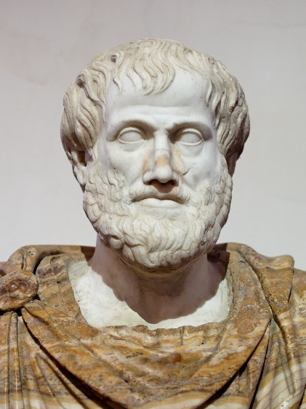
Pareto improvements
Situation A is Pareto superior to situation B if no one is worse off and at least one person is better off
Aristotle: A trade in which both parties engage willingly and knowingly, can only be mutually advantageous
Trade is therefore Pareto improving

Slide 5
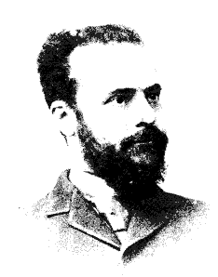
Static Economic Efficiency
Efficiency = Pareto optimality = For some initial distribution of endowments, an allocation is efficient if it is not possible to make one or more persons better off without making at least one person worse off
The Pareto optimum exhausts all Pareto improvements
A perfect market is efficient
This is the First Welfare Theorem

Slide 6


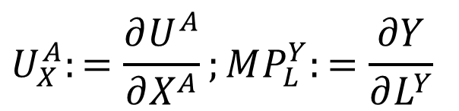
Static Efficiency: Notation
Two persons (A,B), two goods (X,Y), two inputs (L,K)
$$U^{A}=U^{A}\left(X^{A},Y^{A}\right);U^{B}=U^{B}\left(X^{B},Y^{B}\right)$$
$$X=X\left(K^{X},L^{X}\right);Y=Y\left(K^{Y},L^{Y}\right)$$
$$U_{X}^{A}:=\frac{∂U^{A}}{∂X^{A}};MP_{L}^{Y}:=\frac{∂Y}{∂L^{Y}}$$

Slide 7

Efficiency in Consumption
Equal marginal utility ratios =: marginal rate of substitution (MRS)
If not, then the two consumers can exchange commodities at the margin such that both gain
$$\frac{U_{X}^{A}}{U_{Y}^{A}}=\frac{U_{X}^{B}}{U_{Y}^{B}}$$
 | Start | Scenario | dUx | dUy | dU
A | 5/1 | Swap one Y for one X | +5 | -1 | +4
B | 1/5 | Swap one X for one Y | -1 | +5 | +4

Slide 8

Efficiency in Production
Equal marginal production ratios =: marginal rate of transformation (MRT)
If not, it would be possible for producers to exchange some K for some L so that the total production of both goods could be increased from the same total volume of inputs
$$\frac{MP_{L}^{X}}{MP_{K}^{X}}=\frac{MP_{L}^{Y}}{MP_{K}^{Y}}$$

Slide 9
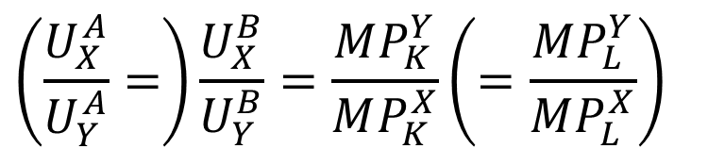
Efficiency in Product-Mix
Marginal utility ratio equals marginal production cost ratio
inverse because RHS is opportunity cost
If not, inputs could be reallocated to make alternative output such that each consumer would be better off
$$\left(\frac{U_{X}^{A}}{U_{Y}^{A}}=\right)\frac{U_{X}^{B}}{U_{Y}^{B}}=\frac{MP_{K}^{Y}}{MP_{K}^{X}}\left(=\frac{MP_{L}^{Y}}{MP_{L}^{X}}\right)$$

Slide 10
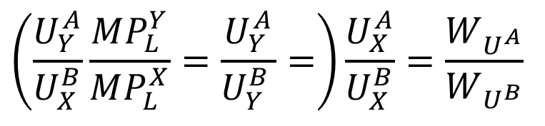

Optimality v Efficiency
There are many efficient solutions, depending on the initial distribution
This is the Second Welfare Theorem
Social welfare function
Optimality
Infeasible if income redistribution is not possible!
$$W=W\left(U^{A},U^{B}\right)$$
$$\left(\frac{U_{Y}^{A}}{U_{X}^{B}}\frac{MP_{L}^{Y}}{MP_{L}^{X}}=\frac{U_{Y}^{A}}{U_{Y}^{B }}=\right)\frac{U_{X}^{A}}{U_{X}^{B}}=\frac{W_{U^{A}}}{W_{U^{B}}}$$

Slide 11
Externalities and public goods
Efficiency and optimality
Static efficiency
Optimality
Market efficiency
Market failure & public policy
Externalities
Pigou taxes
Property rights
Public goods
Public goods and the market
Policy interventions

Slide 12
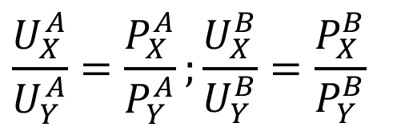
Market: Consumption efficiency
Ratio of marginal utilities equals price ratio
In competitive market, consumers face same prices
So, the market establishes efficiency of consumption
$$\frac{U_{X}^{A}}{U_{Y}^{A}}=\frac{P_{X}^{A}}{P_{Y}^{A}};\frac{U_{X}^{B}}{U_{Y}^{B}}=\frac{P_{X}^{B}}{P_{Y}^{B}}$$
Utility | Price | Scenario | dUx | dUy | dU
1/5 | 5/1 | Sell 1 X, buy 5 Y | -1 | +5*5 | +24

Slide 13
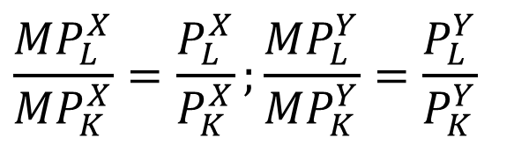
Market: Production efficiency
Ratio of marginal production equals input price ratio
In a competitive market, producers face identical input prices
So, the market establishes efficiency of production
$$\frac{MP_{L}^{X}}{MP_{K}^{X}}=\frac{P_{L}^{X}}{P_{K}^{X}};\frac{MP_{L}^{Y}}{MP_{K}^{Y}}=\frac{P_{L}^{Y}}{P_{K}^{Y}}$$

Slide 14


Market: Product-mix efficiency
$$P_{X}=MC_{X}=\frac{P_{K}^{X}}{MP_{K}^{X}}=\frac{P_{L}^{X}}{MP_{L}^{X}} \\ P_{Y}=MC_{Y}=\frac{P_{K}^{Y}}{MP_{K}^{Y}}=\frac{P_{L}^{Y}}{MP_{L}^{Y}}$$
Price equals ratio of input price and marginal productivity
In a competitive market, producers supply at marginal cost
So, the market establishes efficiency of product-mix
$$\left(\frac{U_{X}^{B}}{U_{Y}^{B}}=\right)\frac{P_{X}}{P_{Y}}=\frac{MP_{K}^{Y}}{MP_{K}^{X}}\frac{P_{K}^{X}}{P_{K}^{Y}}$$

Slide 15
Markets are efficient, iff
Markets exist for all goods and services
Property rights are fully assigned
All goods and services are private
No externalities exist
All markets are perfectly competitive
Long run average costs are non-decreasing
All agents have perfect information

Slide 16
Resources and Environment
Many natural resources are not bought and sold on markets
Clean air, wilderness
Many resources are public goods ...
Climate
... or open access
Ocean fisheries
Other resources are traded on imperfect markets
Land, minerals, energy
Other environmental issues are externalities

Slide 17
Externalities and public goods
Efficiency and optimality
Static efficiency
Optimality
Market efficiency
Market failure & public policy
Externalities
Pigou taxes
Property rights
Public goods
Public goods and the market
Policy interventions

Slide 18

Externalities
External effect is said to occur if the production or consumption of one agent affects the utility of another agent in an unintended way, and when no compensation is made
Externality: unintended, uncompensated impact of an economic activity on a third party
External effect = externality = external cost = external diseconomy
External effect may be beneficial or adverse, consumption or production related
If taxed, the externality is said
to be internalised

Slide 19
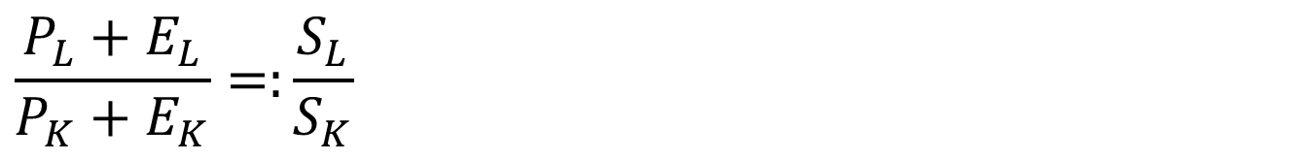


Externalities and Efficiency
$$\frac{MP_{L}^{X}}{MP_{K}^{X}}=\frac{S_{L}}{S_{K}}$$
Production efficiency:
Split price in private + external = social
Market, private optimisation would yield
$$\frac{P_{L}+E_{L}}{P_{K}+E_{K}}=:\frac{S_{L}}{S_{K}}$$
$$\frac{PMP_{L}^{X}}{PMP_{K}^{X}}=\frac{P_{L}}{P_{K}}$$

Slide 20
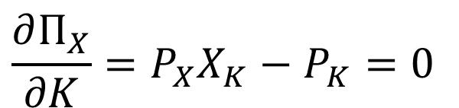
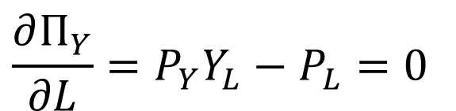
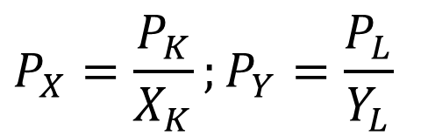
Individual Optimisation
$$Π_{X}=P_{X}X(K,M(L))−P_{K}K;Π_{Y}=P_{Y}Y(L)−P_{L}L$$
For example, the workers
of factory Y cause
congestion that hinders
the driverless car of transport
company X.
$$\frac{∂Π_{X}}{∂K}=P_{X}X_{K}−P_{K}=0$$
$$\frac{∂Π_{Y}}{∂L}=P_{Y}Y_{L}−P_{L}=0$$
$$P_{X}=\frac{P_{K}}{X_{K}};P_{Y}=\frac{P_{L}}{Y_{L}}$$

Slide 21
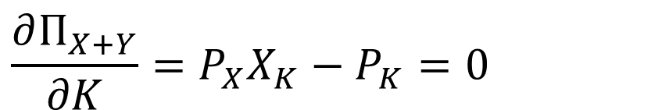
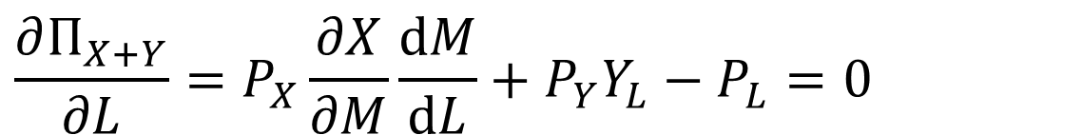
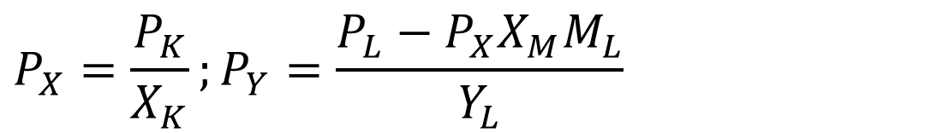
Joint Optimisation
$$Π_{X+Y}=P_{X}X(K,M(L))+P_{Y}Y(L)−P_{K}K−P_{L}L$$
$$\frac{∂Π_{X+Y}}{∂K}=P_{X}X_{K}−P_{K}=0$$
$$\frac{∂Π_{X+Y}}{∂L}=P_{X}\frac{∂X}{∂M}\frac{dM}{dL}+P_{Y}Y_{L}−P_{L}=0$$
$$P_{X}=\frac{P_{K}}{X_{K}};P_{Y}=\frac{P_{L}−P_{X}X_{M}M_{L}}{Y_{L}}$$

Slide 22
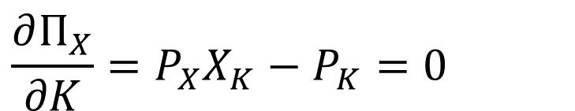
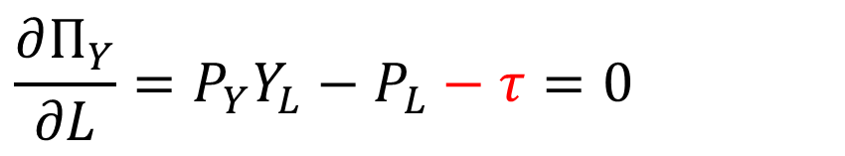
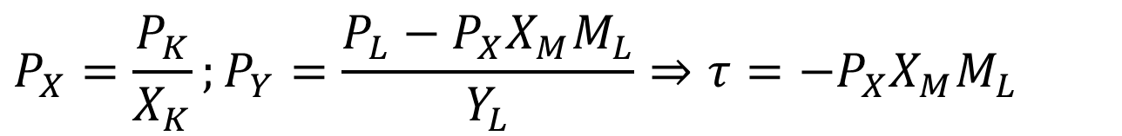
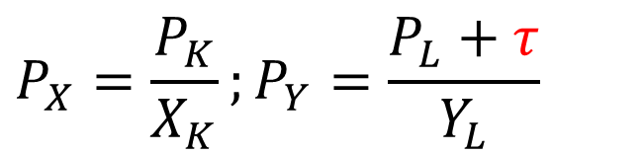
Individual Optimisation with Tax
$$Π_{X}=P_{X}X(K,M(L))−P_{K}K;Π_{Y}=P_{Y}Y(L)−P_{L}L−τL$$
$$\frac{∂Π_{X}}{∂K}=P_{X}X_{K}−P_{K}=0$$
$$\frac{∂Π_{Y}}{∂L}=P_{Y}Y_{L}−P_{L}−τ=0$$
$$P_{X}=\frac{P_{K}}{X_{K}};P_{Y}=\frac{P_{L}+τ}{Y_{L}}$$
Pigou tax
Joint optimisation
$$P_{X}=\frac{P_{K}}{X_{K}};P_{Y}=\frac{P_{L}−P_{X}X_{M}M_{L}}{Y_{L}}⇒τ=−P_{X}X_{M}M_{L}$$

Slide 23
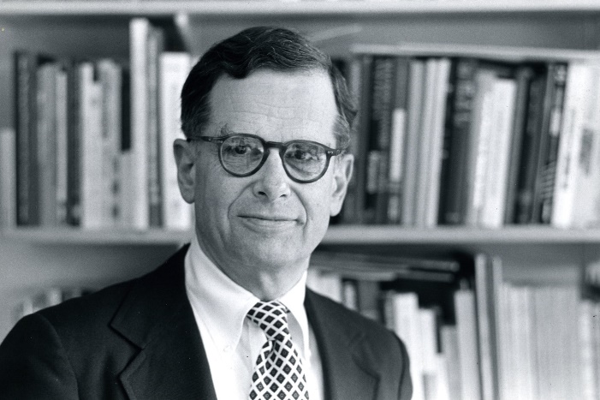
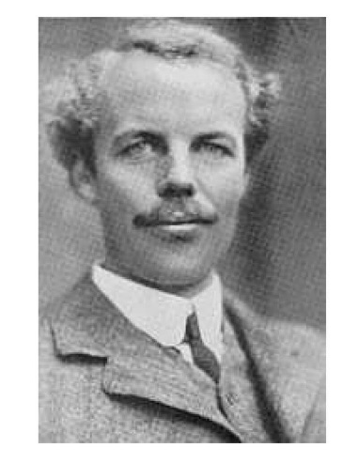
Pigou Tax
That tax that exactly restores the social optimum (τ=P_{X}X_{M}M_{L}) in case of externalities is known as the Pigou tax
Note that Pigou was thinking of agglomeration economies rather than externalities. The Pigou tax above is really due to Francis Bator

Slide 24
If the amount of investment in any industry was carried exactly to the point at which the value of the marginal social net product there is equal to the central value of marginal social net products, the national dividend, so far as that industry is concerned, would be maximised. Disregarding the possibility of multiple maximum positions, I propose, for convenience, to call the investment that would then be made in the industry the ideal investment and the output that would be obtained the ideal output.
Under conditions of simple competition, if in any industry the value of the marginal social net product of investment is greater than the value of the marginal private net product, this implies that the output obtained is less than the ideal output: if the value of the marginal social net product is less than the value of the marginal private net product, this implies that the output obtained is greater than the ideal output.
It follows that, under conditions of simple competition, for every industry in which the value of the marginal social net product is greater than that of the marginal private net product, there will be certain rates of bounty, the granting of which by the State would modify output in such a way as to make the value of the marginal social net product there more nearly equal to the value of the marginal social net product of resources in general, thus – provided that the funds for the bounty can be raised by a mere transfer that does not inflict any indirect injury on production – increasing the size of the national dividend and the sum of economic welfare; and there will be one rate of bounty, the granting of which would have the optimum effect in this respect.
In like manner, for every industry in which the value of the marginal social net product is less than that of the marginal private net product, there will be certain rates of tax, the imposition of which by the State would increase the size of the national dividend and increase economic welfare; and one rate of tax, which would have the optimum effect in this respect.

Slide 25
Pigou Tax
That tax that exactly restores the social optimum (τ=P_{X}X_{M}M_{L}) in case of externalities is known as the Pigou tax
Note that this is frequently, but incorrectly, referred to as the polluter pays principle

Slide 26
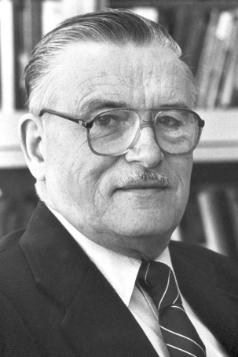
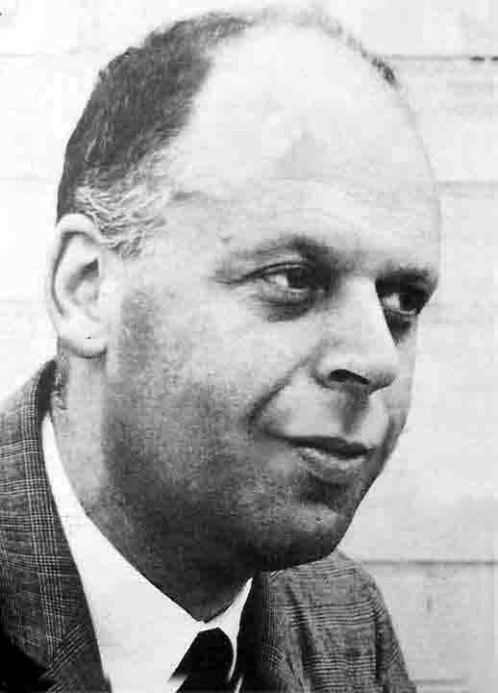
Pigou Tax
That tax that exactly restores the social optimum (τ=P_{X}X_{M}M_{L}) in case of externalities is known as the Pigou tax
Buchanan thought that the victims of pollution should be compensated, but Baumol showed that this is not the case
The Pigou tax restores efficiency
Compensation is a lump-sum transfer
This income transfer could go to the victims or to the government
Second Welfare Theorem: A Pareto optimum in either case

Slide 27
Externalities and public goods
Efficiency and optimality
Static efficiency
Optimality
Market efficiency
Market failure & public policy
Externalities
Pigou taxes
Property rights
Public goods
Public goods and the market
Policy interventions

Slide 28
Property Rights
Property is
The right to use
The right to exclude
The right to destroy
Property rights are often attenuated

Slide 29

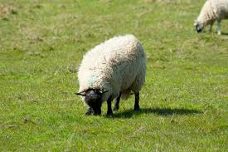


Public Goods
 | Excludable | Non-excludable
Rivalrous | Private good | Open-access resource
Non-rivalrous | Club good | Public good
The problem with public goods is that they are underprovided – because the provider is not sufficiently rewarded – and overconsumed – because the consumer is not sufficiently deterred

Slide 30
Public Goods
Underprovision
The provider gets only a fraction of the benefits of her investment, the rest going to others, and therefore invests less
A social planner counts the total benefit and thus invests more
Overconsumption
The consumer feels only a fraction of the losses imposed by her decisions, the rest being felt by others, and therefore consumes more
A social planner counts the total cost and thus consume less

Slide 31
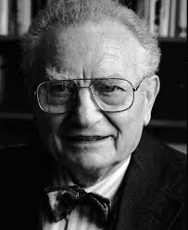
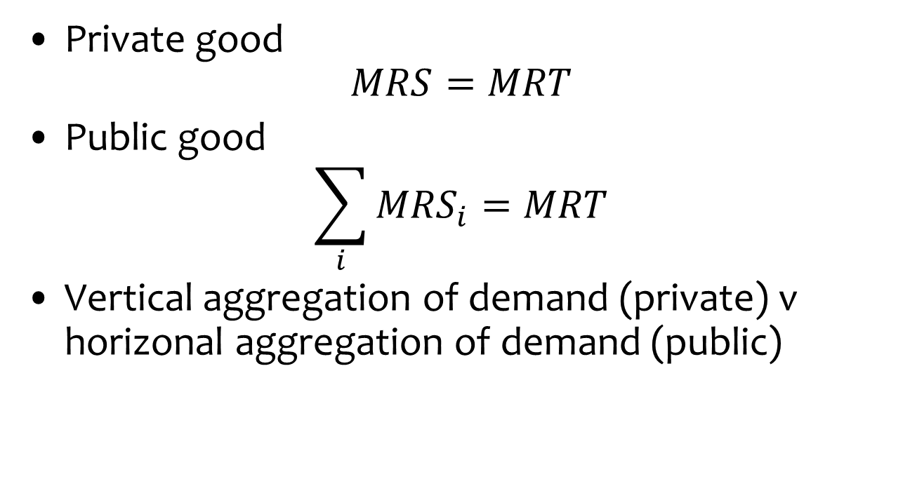
Samuelson Condition
Private good
$$MRS=MRT$$
Public good
$$\sum_{i}{{MRS}_{i}}=MRT$$
Vertical aggregation of demand (private) v horizonal aggregation of demand (public)

Slide 32
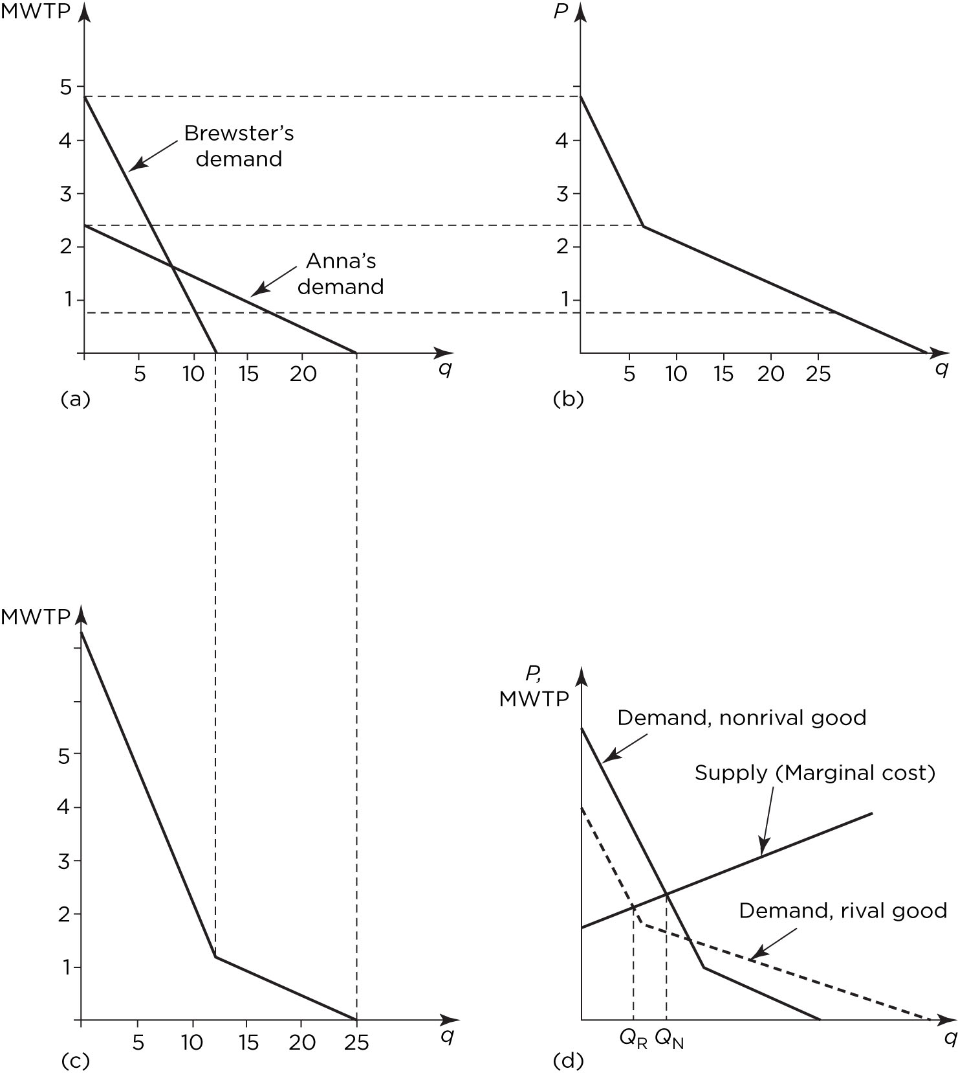

Slide 33
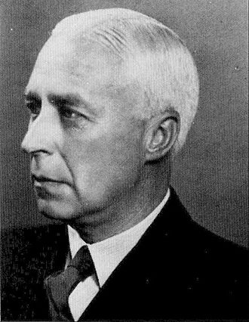
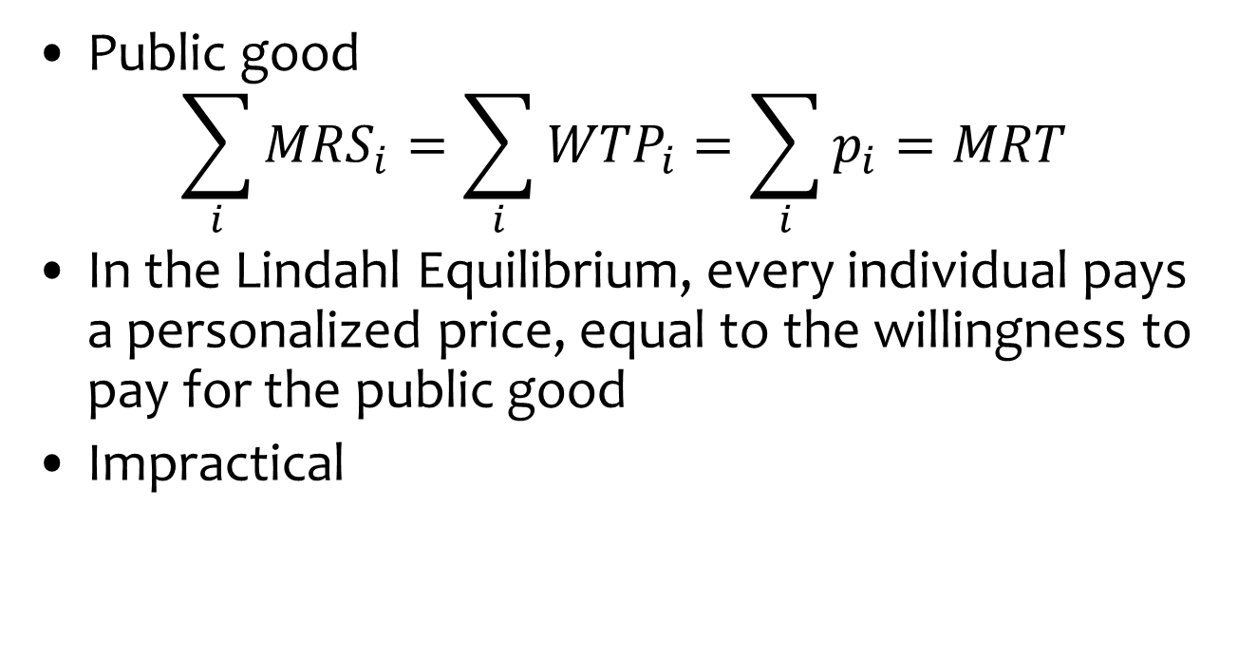
Lindahl Equilibrium
Public good
$$\sum_{i}{{MRS}_{i}}=\sum_{i}{{WTP}_{i}}=\sum_{i}{p_{i}}=MRT$$
In the Lindahl Equilibrium, every individual pays a personalized price, equal to the willingness to pay for the public good
Impractical

Slide 34
Externalities and public goods
Efficiency and optimality
Static efficiency
Optimality
Market efficiency
Market failure & public policy
Externalities
Pigou taxes
Property rights
Public goods
Public goods and the market
Policy interventions

Slide 35
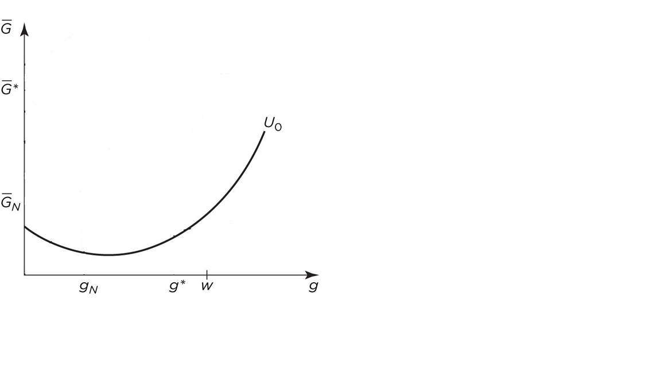

Equilibrium v Optimum Provision
N identical agents with utility
$$U=u\left(w,G\right)=u\left(w−g,g+\overline{G}\right)=u(w−g,g+(n−1)g)$$

Slide 36
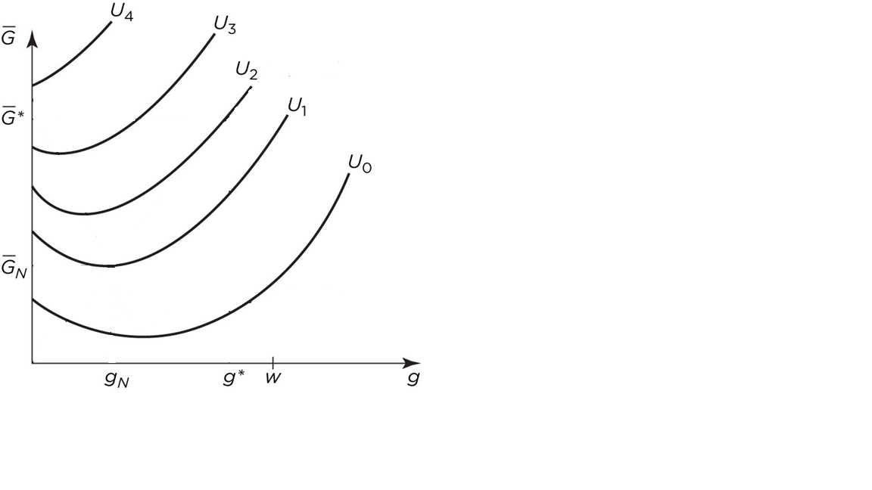
Equilibrium v Optimum Provision
N identical agents with utility
$$U=u\left(w,G\right)=u\left(w−g,g+\overline{G}\right)=u(w−g,g+(n−1)g)$$

Slide 37
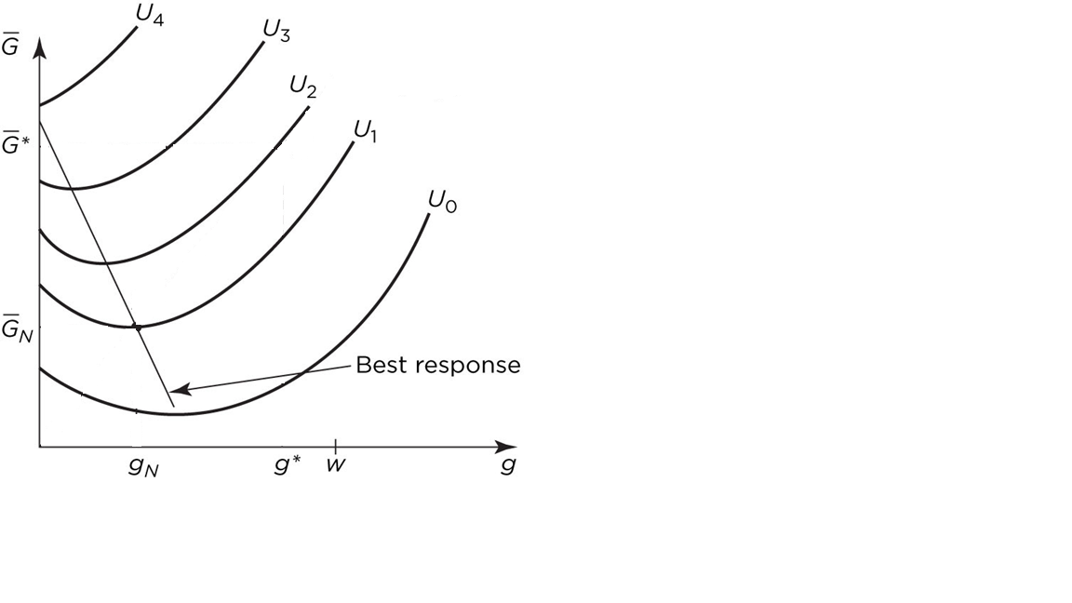
Equilibrium v Optimum Provision
N identical agents with utility
$$U=u\left(w,G\right)=u\left(w−g,g+\overline{G}\right)=u(w−g,g+(n−1)g)$$

Slide 38
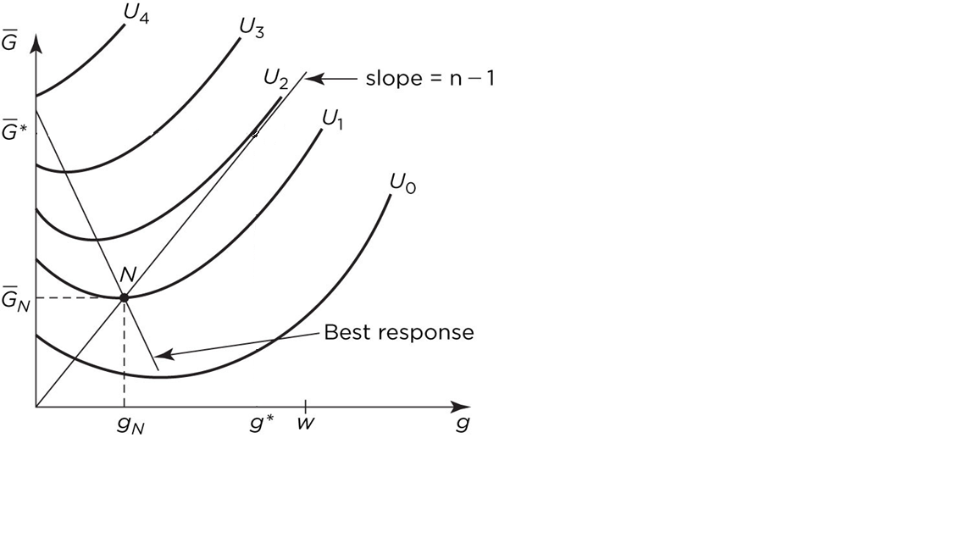
Equilibrium v Optimum Provision
N identical agents with utility
$$U=u\left(w,G\right)=u\left(w−g,g+\overline{G}\right)=u(w−g,g+(n−1)g)$$

Slide 39
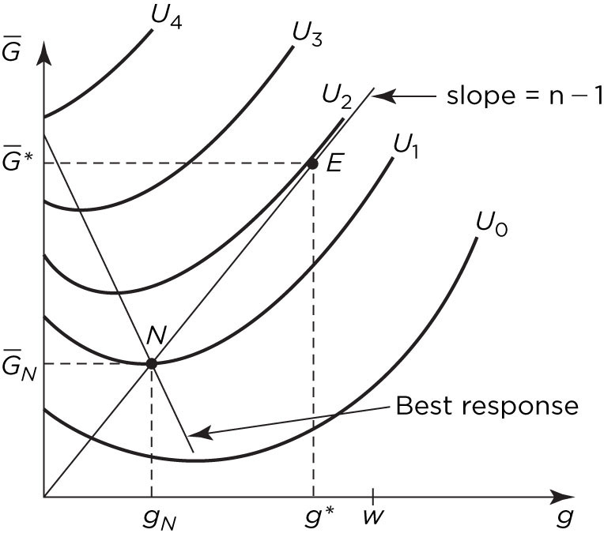
Equilibrium v Optimum Provision
N identical agents with utility
$$U=u\left(w,G\right)=u\left(w−g,g+\overline{G}\right)=u(w−g,g+(n−1)g)$$
optimum where supply = marginal utility
equilibrium where best response = supply

Slide 40
Public Goods
Underprovision
The provider gets only a fraction of the benefits of her investment, the rest going to others, and therefore invests less
A social planner counts the total benefit and thus invests more
Overconsumption
The consumer feels only a fraction of the losses imposed by her decisions, the rest being felt by others, and therefore consumes more
A social planner counts the total cost and thus consume less

Slide 41
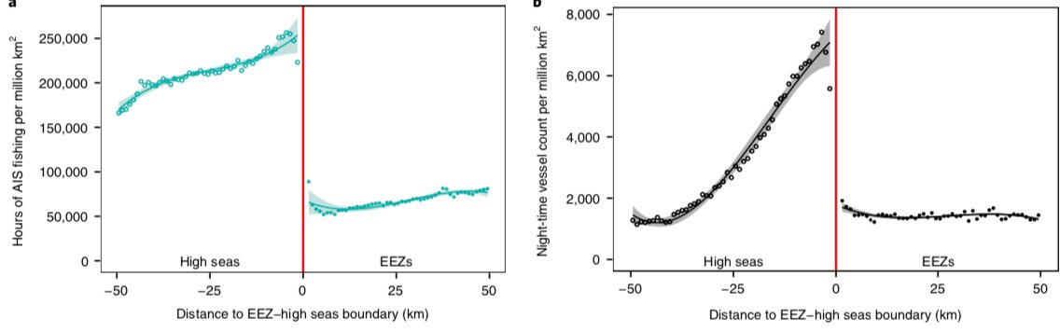
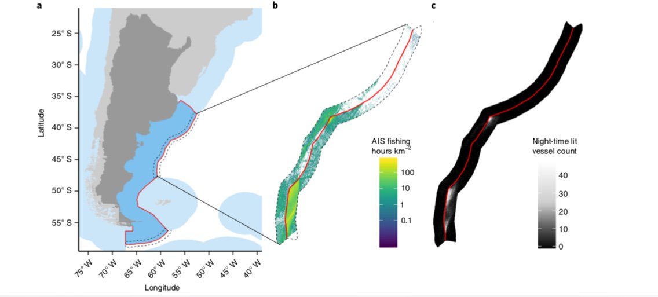

Slide 42
Policy
Public goods
Public provision from tax revenue
Common goods
Regulate access with tradable access quota; a tax on use
Club goods
Health and safety regulation

Slide 43
Summary
Externalities
Unintended side-effect
Suboptimal allocation
Impose Pigou tax
Public goods
Market works for private goods
Overconsumption, underprovision
Public supply, regulate access, use charges

